Slide 1

Introduction to Sociology
Origins and Development
Ms. Kauser Malik
Lecturer (Sciences & Humanities)

Slide 2
Reference Textbooks
Sociology A Down-to-Earth Approach Thirteenth Edition (Will be shared on google classroom)
https://www.iasgurukul.com/Sociology-study-material-2.pdf
Sociology, Schaefer and Lamm (Latest Edition)
Sociology, John J. Macionis (Latest Edition)
Links:
https://www.scribd.com/doc/268254571/Richard-T-Schaefer-Robert-P-Lamm-Sociology#
https://learnclax.com/utilities/download-manager.php?book-id=4912

Slide 3
Learning Objectives
Definition and meaning of Sociology
Origins of Sociology
Sociology as a Science
Relationship of Sociology with other Social Sciences

Slide 4

Why you “chose” to enroll at FAST?

Slide 5
The Power of Society

Slide 6

The Power of Society
Society refers to people who live in a defined territory and share a way of life.
The power of society to guide choices in selecting marriage partners.
Free will vs Society - Do we simply “pick” our marriage partners?
We tend to think of love and marriage as very personal matters, however, society does guide the process of selecting a spouse.
Large majority of married couples are about the same age, have similar educational backgrounds, and share the same racial and ethnic identity.

Slide 7
Career (doctor, engineer), marriage/divorce (age), children (child bearing practices, schooling, contraception), higher studies (age, financial standing, family structure and size)
Lillian Rubin (1976) found that higher-income women typically expected the men they married to be sensitive to others, to talk readily, and to share feelings and experiences. Lower-income women, she found, had very different expectations and were looking for men who did not drink too much, were not violent, and held steady jobs. Hence, what women expect in a marriage partner has a lot to do with social class position.
Suicides – Social Integration (Social ties, freedom, gender, wealth)

Slide 8
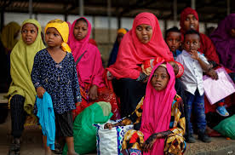
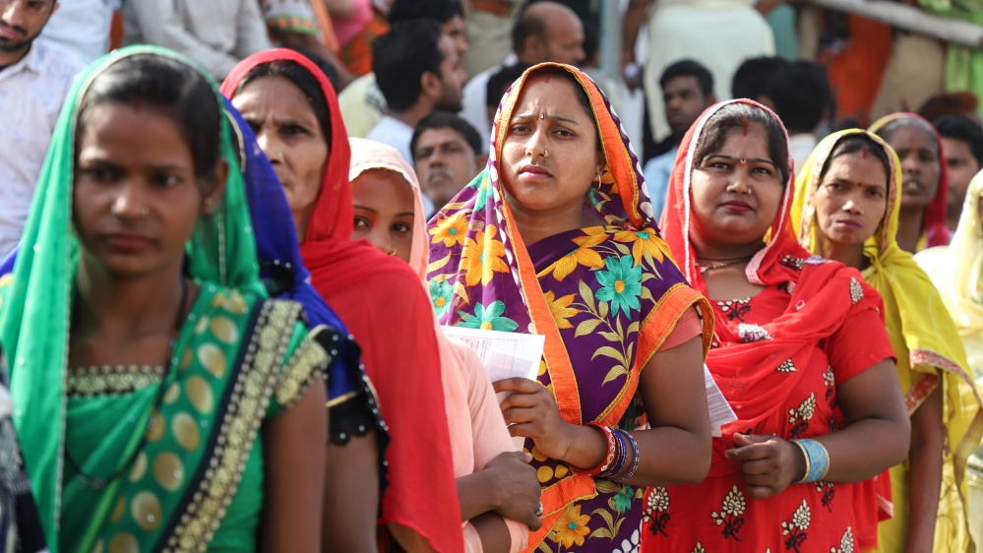



Slide 9

Definition
The word Sociology is derived from the Latin Word ‘socius’ which means ‘society, companions’ and the Greek word ‘logos’ means ‘study or advanced study’.
A social science which systematically study and focus on society, human social behavior, patterns of social relationships, social interaction, and aspects of culture associated with everyday life.
It is the study of human societies, their interactions, and the processes that preserve and change them.
The focus of sociology is the group not the individual.
Main goal is to understand social situations and look for repeating patterns in society
Notes:
https://www.iasgurukul.com/Sociology-study-material-2.pdf

Slide 10
Society
At the center of the sociological perspective is the question of how groups influence people, especially how people are influenced by their society—a group of people who share a culture and a territory.
Sociological Perspective
Understanding human behavior by placing it within its broader social context. The sociological perspective stresses the social contexts in which people live. It examines how these contexts influence people’s lives. A key basis of the sociological perspective is the concept that the individual and society are inseparable. It is impossible to study one without the other.
Sociological Imagination
Incorporating a sociological perspective reminds us that we are always participating in something larger than ourselves. Using our sociological imagination, we can begin to see our micro, personal troubles in the context of macro, public issues.
Sociologists look at how jobs, income, education, gender, race–ethnicity, and age affect people’s ideas and behavior.

Slide 11
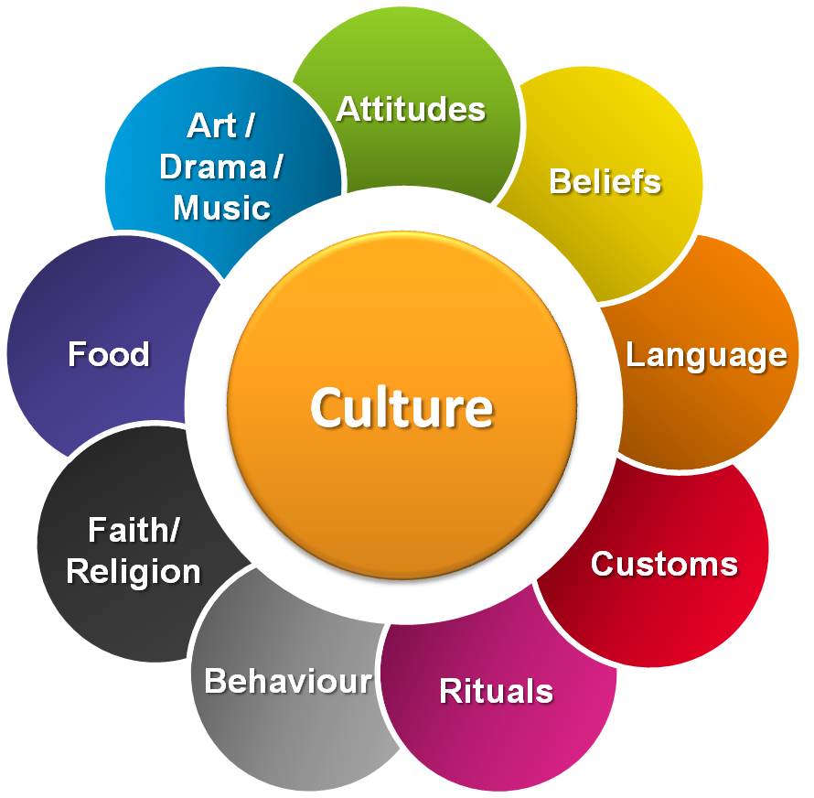

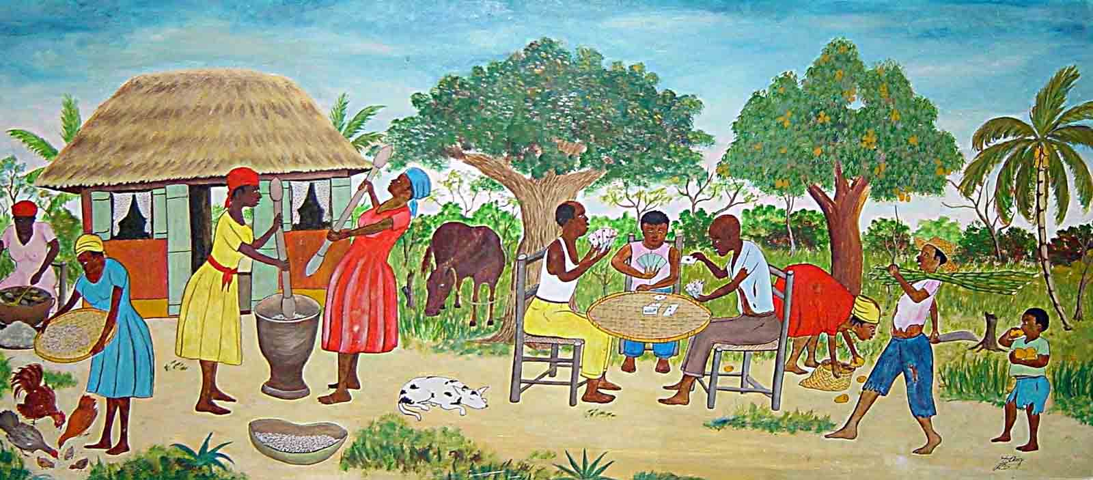
Difference between Society and Culture?

Slide 12

Society is a group of people whose members interact, reside in a definable area, and share a culture.
A culture includes the group’s shared practices, values, beliefs, norms and artifacts.

Slide 13

COVID

Slide 14
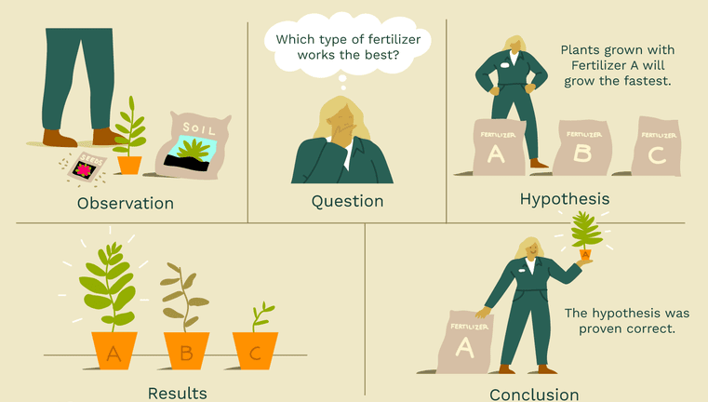
Scientific Method
Observation
Question
Hypothesis
Results
Conclusion

Slide 15
Sociology as a Science
Sociology is similar to the other social sciences in some ways but it is distinct because it looks at all social institutions e.g., family, education, religion, government (political), economy etc. It focuses on industrialized societies, and looks at external factors which influence people.
According to Auguste Comte and Durkheim, “Sociology is a science because it adopts and applies the scientific method. Sociology does make use of scientific methods in the study of its subject matter. It is a science because of the following reasons:
Adopts scientific method
Makes observations
Objectivity is possible
Describes cause-effect relationship
Makes measurement
Makes predictions
Makes generalizations

Slide 16

Sociology and Political Science
Sociology focuses on how the political system affects other institutions in society, whereas political science devotes more attention to the forces that shape political systems and the theories for understanding these forces.
However, both disciplines share an interest in why people vote the way they do, why they join political movements, and how the mass media are changing political events. Like political scientists, sociologists study how people govern one another, especially how those in power affect people’s lives.

Slide 17
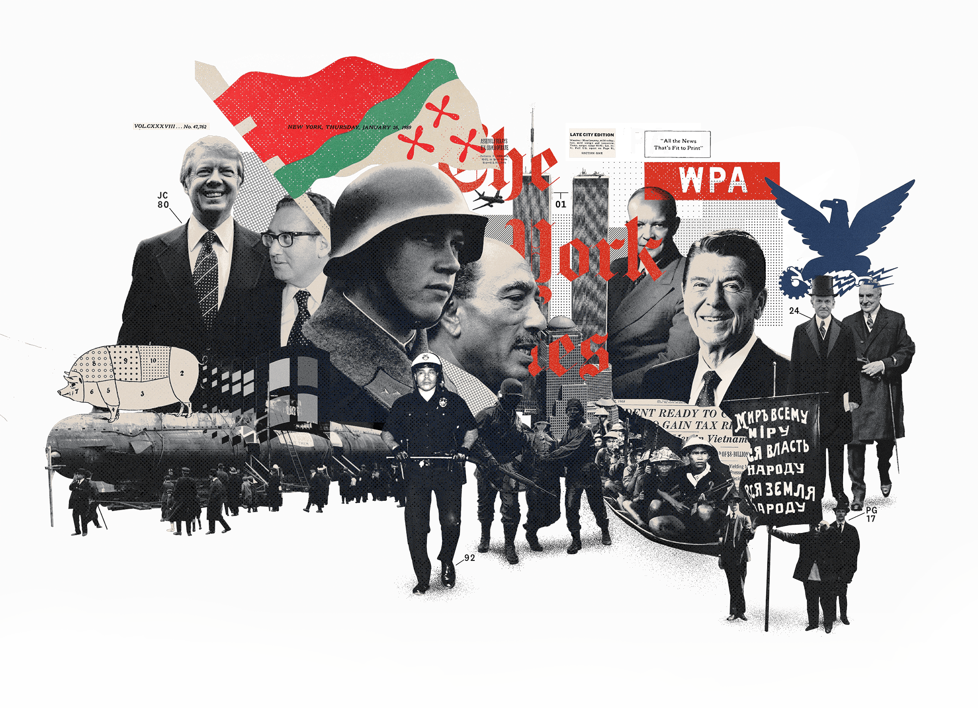
Sociology and History
The study of history involves looking at the past to learn what happened, when it happened, and why it happened.
Sociology also looks at historical events within their social contexts to discover why things happened and, more important, to assess what their social significance was and is.
Historians provide a narrative of the sequence of events during a certain period and might use sociological research methods to learn how social forces have shaped historical events.
Sociologists examine historical events to see how they influenced later social situations.

Slide 18
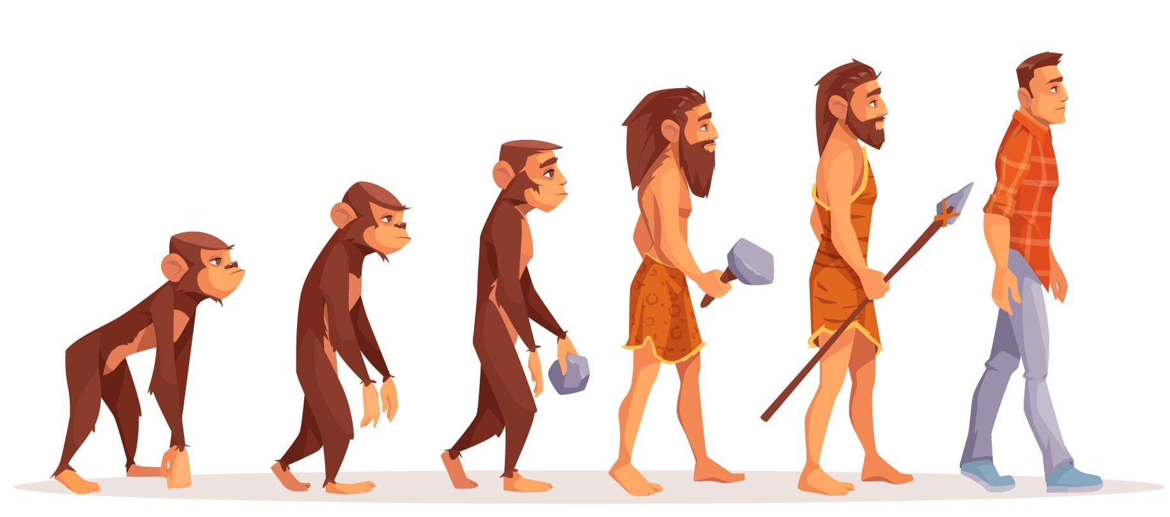
Sociology and Cultural Anthropology
Sociologists tend to study groups and institutions within large, often modern, industrial societies, using research methods that enable them rather quickly to gather specific information about large numbers of people.
In contrast, cultural anthropologists often immerse themselves in another society for a long period of time, trying to learn as much as possible about that society and the relationships among its people.
Like anthropologists, sociologists also study culture; they, too, do research on group structure and belief systems, as well as on how people communicate with one another.
However, sociologists focus primarily on industrialized and post industrialized societies.

Slide 19

Sociology and Psychology
Psychology is the study of individual behavior and mental processes.
Generally, however, psychology studies the individual, and sociology studies groups of individuals as well as society’s institutions.
And like psychologists, sociologists also study how people adjust to the difficulties of life.
And unlike psychologists, sociologists study stress factors external to the individual to determine what influences people and how they adjust to life.
Psychology and Sociology overlap in a subdivision known as social psychology—the study of how human behavior is influenced and shaped by various social situations.

Slide 20

Sociology and Economics
Economists study price and availability factors, whereas, sociologists are interested in the social factors that influence a person’s economic decisions.
Like economists, sociologists do research on how a society’s goods and services are distributed, especially how that distribution results in inequality.
Unlike economists and political scientists, sociologists do not concentrate on a single social institution.

Slide 21

Sociology and Social Work
The main goal of social work is to help people solve their problems, whereas the aim of sociology is to understand why the problems exist.
Social workers provide help for individuals and families who have emotional and psychological problems or who experience difficulties that stem from poverty or other ongoing problems rooted in the structure of society. Sociologists provide many of the theories and ideas used to help others.

Slide 22
Origins of Sociology

Slide 23
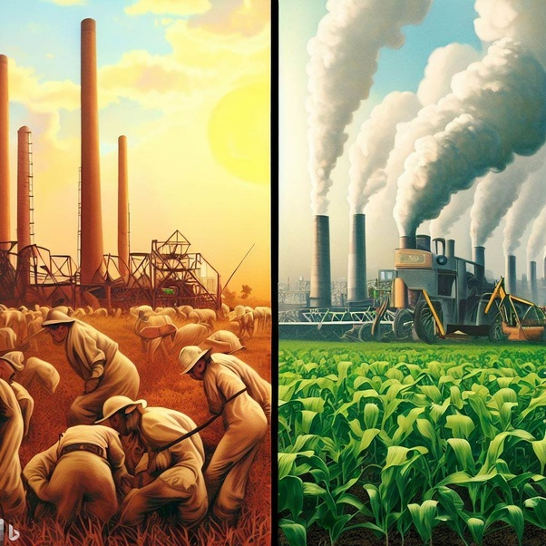
Social Change and Sociology
Three kinds of change were especially important in the development of sociology:
the rise of a factory-based industrial economy,
the explosive growth of cities, and new ideas about democracy and
political rights.
1) New Industrial Economy
During the Middle Ages in Europe, most people plowed fields near their homes or worked in small-scale manufacturing.
By the end of the eighteenth century, inventors used new sources of energy. Instead of laboring at home or in small groups, workers became part of a large and anonymous labor force, under the control of strangers who owned the factories.

Slide 24
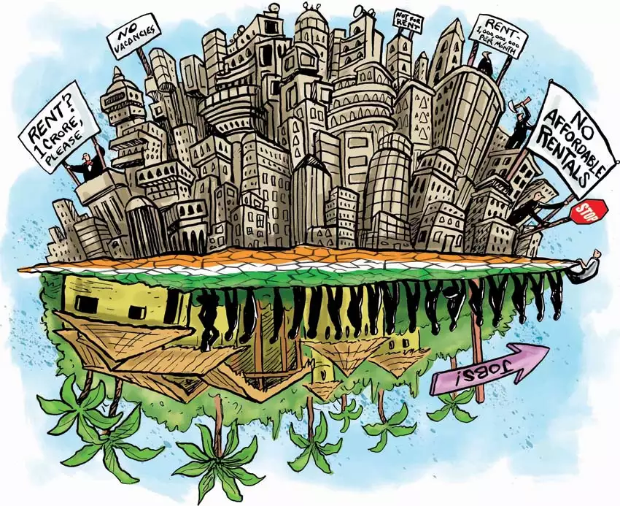
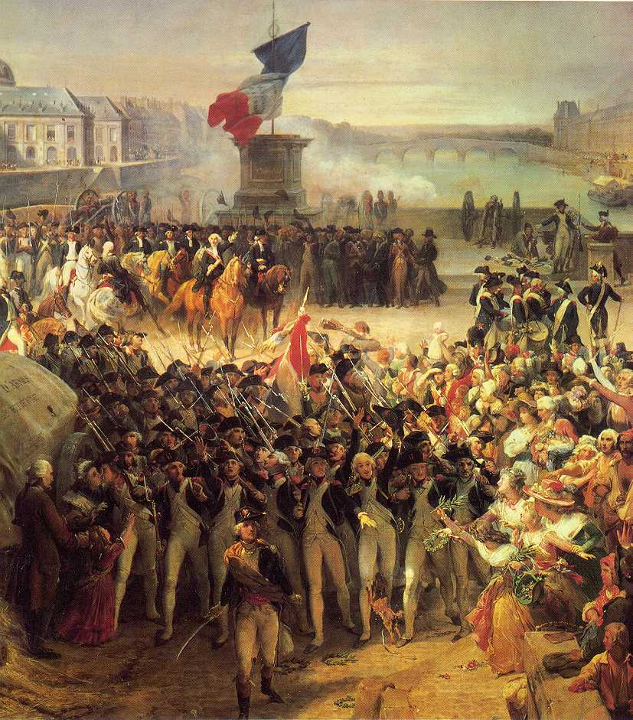
2) The Growth of Cities
Across Europe, landowners took part in what historians call the enclosure movement
As cities grew larger, these urban migrants faced many social problems, including pollution, crime, and homelessness
3) Political Change
As cities grew, tradition came under attack. In the new political climate, philosophers spoke of personal liberty and individual rights.
The French Revolution, which began in 1789, marked as a turning point in history of human struggle for freedom and equality, it put an end to the feudal system
Huge factories, exploding cities, a new spirit of individualism—these changes combined to make people more aware of their surroundings.

Slide 25
Three main events set the stage for the challenge to tradition and the emergence of Sociology:
Industrial Revolution (1750)
The American and French Revolutions (1789 until 1799)
Imperialism - Empire Building (1776)
Notes:
With traditional answers failing, the next step was to apply the scientific method to questions about social life. The result was the birth of sociology.

Slide 26
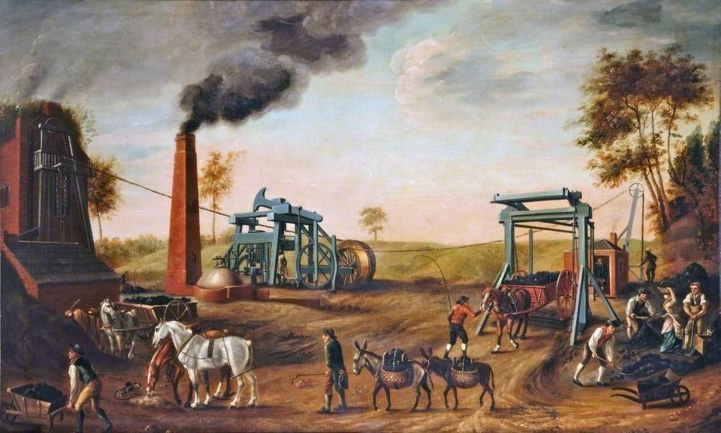
Industrial Revolution

Slide 27
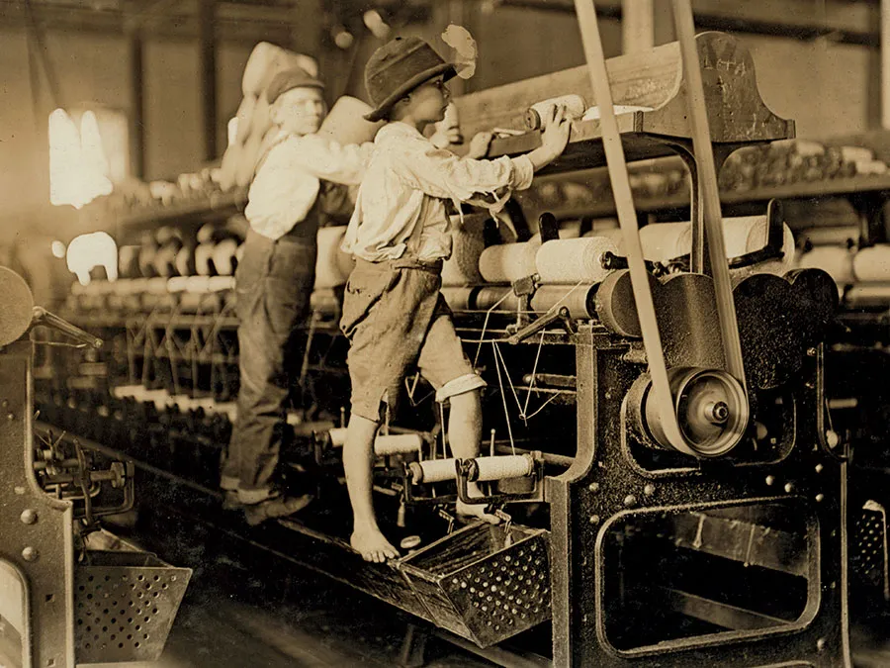
Industrial Revolution
Refers to the period of rapid social, economic, demographic, and technological change which took place in Britain from 1970s-1980s.
It defines the transformation of Britain from a predominantly rural and agrarian society to an increasingly urban one based on manufacturing and industry.

Slide 28
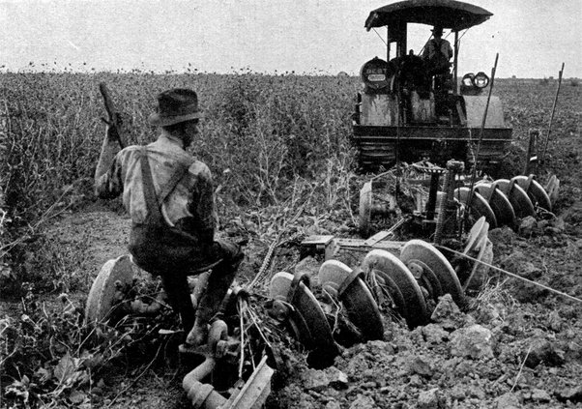
Important Features of Industrial Revolution
Demographic transition
Agricultural revolution improving farming techniques
Technological inventions and developments, in particular that of steam power, were crucial to the operation of trains, ships, and the larger factories.
Increasingly large investments of capital which enabled the growth of powerful manufacturing industries
Revolution in transportation

Slide 29
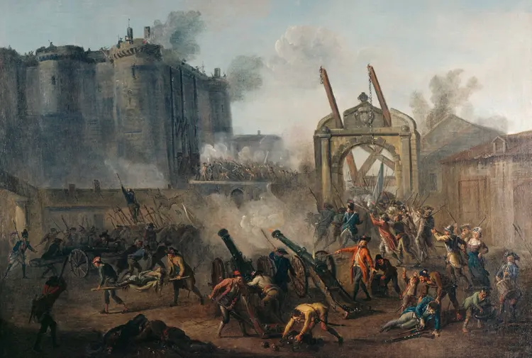
French Revolution

Slide 30
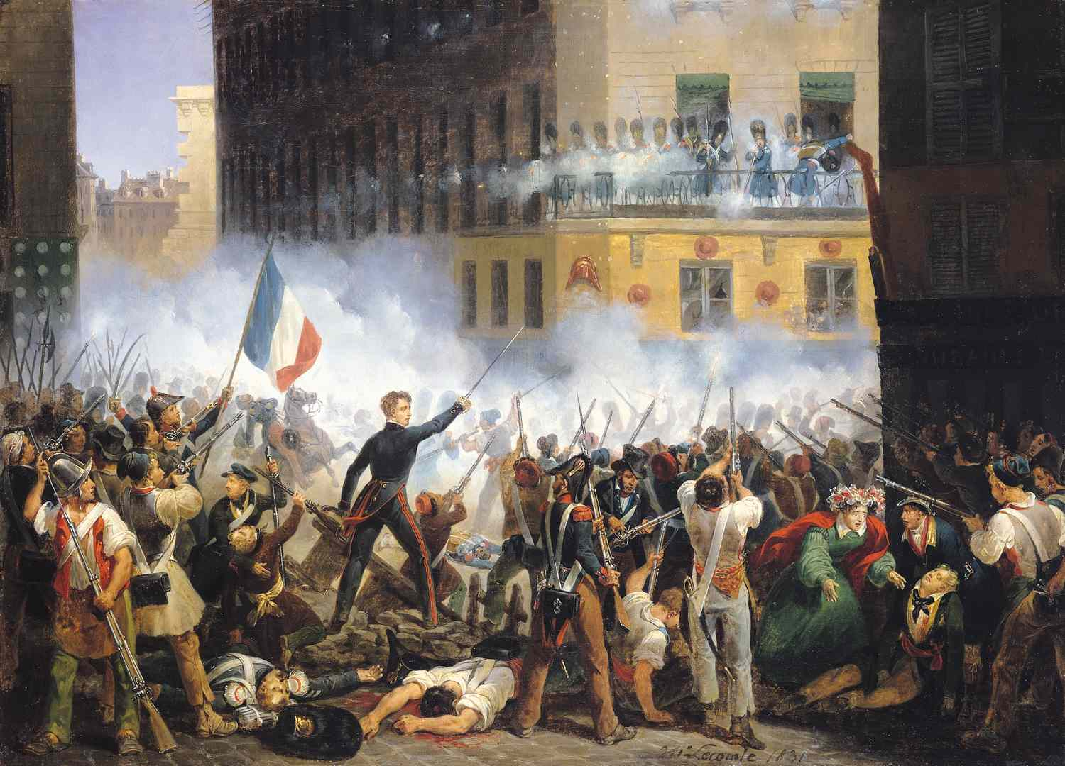
French Revolution
The French Revolution was a period of political and societal change in France that began with the Estates General of 1789, and ended in 1799 and the formation of the French Consulate.

Slide 31
Causes of French Revolution
Social
Political
Intellectual
Economic
The social conditions in France in the late 18th century were extremely unequal and exploitative.
The privileged classes were excused from paying taxes. The Third Estate was more and more burdened with them leading to economic unrest.
The King of France, Louis XVI was an extremely autocratic who led a life of obscene luxury. This led to a lot of disenchantment among the masses, who then, were leading life of extreme poverty and widespread hunger.
The Philosophers of 18th century rejected the paradigm of absolute monarchy and promulgated the doctrine of equality of man and sovereignty of people. They played a pivotal role in exposing the fault lines of the old political system, i.e. the ancient regime, and articulating the popular discontent.

Slide 32
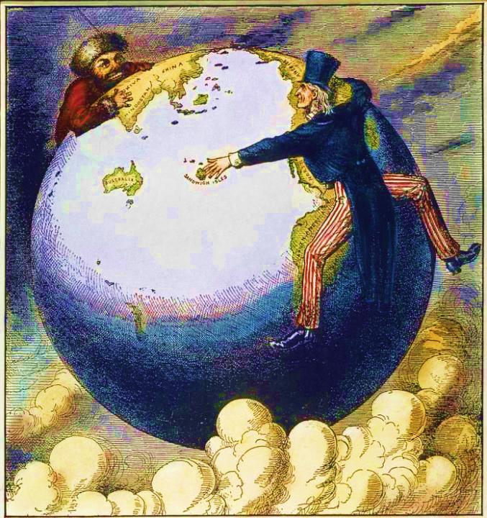
Imperialism
(Empire Building)

Slide 33
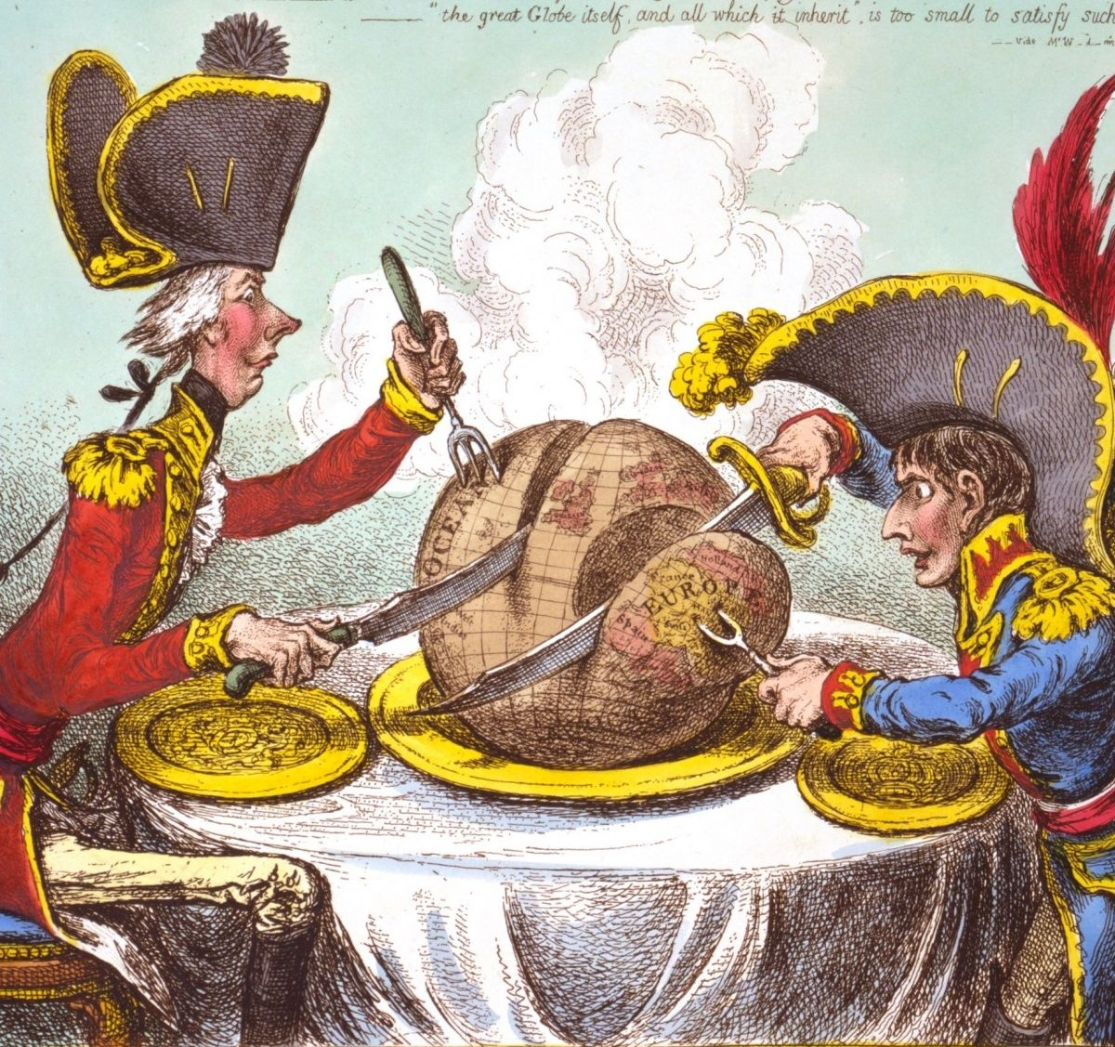
Imperialism (Empire Building)
The Europeans had conquered so many countries that their new colonies stretched across the world, from Asia and Africa to North and South America.
This exposed them to radically different ways of life, and they began to ask why cultures differ.

Slide 34
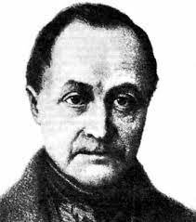
Auguste Comte and Positivism
Coined the term “Sociology” in his book “Positive Philosophy”.
He suggested that we apply the scientific method to social world, a process known as positivism.
Wondered what held society together
Auguste Comte (1798–1857), a French philosopher who is credited as the founder of Sociology began to analyze the bases of the social order.

Slide 35
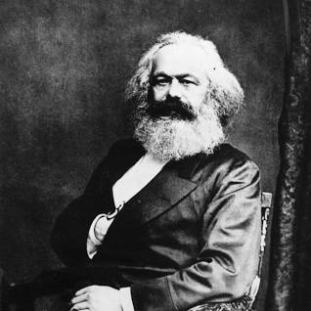
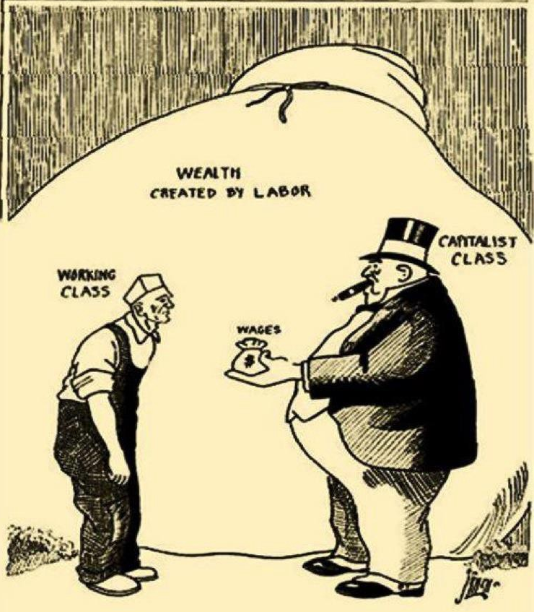
Karl Marx and Class Conflict
Karl Marx (1818–1883) believed that the roots of human misery lay in class conflict, the exploitation of workers by those who own the means of production. Marx published The Communist Manifesto in 1848.
He said that society is made up of two social classes, and they are natural enemies of one another.
Looked at exploitation of workers (proletariat/worker/oppressed) by capitalists, those who own the means of production (bourgeoisie/owner/oppressor). The bourgeoisie - the capitalists, who own the capital, land, factories, and machines) and the proletariat (the exploited workers).
Eventually, the workers will unite and break their chains of bondage. The workers’ revolution will be bloody, but it will guide in a classless society, one free of exploitation.
People will work according to their abilities and receive goods and services according to their needs.

Slide 36
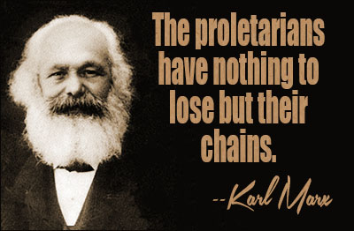
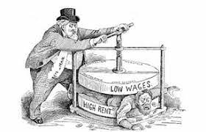
Marx's Social Economic Systems
Marx argues that society is composed of two main classes:
Capitalists
are the business owners who organize the process of production and who own the means of production such as factories, tools, and raw material, and who are also entitled to any and all profits.
The other, much larger class is composed of labor (which Marx termed the "proletariat"). Laborers do not own or have any claim to the means of production, labor works only in return for a money wage.
Proletariat
Marx argued that because of this uneven arrangement, capitalists exploit workers.

Slide 37
Marx’s vision of Communism
In Marx’s evolutionary view, communism is the type of society that would emerge following the overthrow of capitalism. It would be a society characterized by the abolition of: private property, profit, the division of labor, and social classes.
Consequently, communism would represent the “end of history”
The logic of material production in communist society would require each person to contribute their labor to the everyday material and social good of the community on the basis of their diverse and multifaceted abilities
The socialist system Marx envisioned would also require what he called “a dictatorship of the proletariat”—a temporary government in which the needs of the workers were protected. Eventually, this would lead to a true socialist society.
Notes:
In a communist society – i.e., a society in which private property, profit, and inequality would be eliminated and thus no one class (e.g., slave-owners, feudal lords, capitalists) would control the means of production (slaves, land, capital) – there would be no more tensions and contradictions to resolve. Hence the dialectic of history (dialectical materialism) would come to a stop.

Slide 38
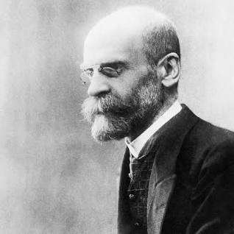

Emile Durkheim and Social Integration
Grew up in France, his major professional goal was to get sociology recognized as a separate academic discipline.
Second goal was to show how social forces affect people’s behavior.
Compared the suicide rates of several European countries and found that each country has a different suicide rate—and that these rates remain about the same year after year.
Also found that different groups within a country have different suicide rates and that these, too, remain stable from year to year: Males are more likely than females to kill themselves, Protestants more likely than Catholics or Jews, and the unmarried more than the married.

Slide 39

Concluded that suicide is not due to personal reasons. Instead, social factors underlie suicide, which is why a group’s rate remains fairly constant year after year.
Identified social integration, the degree to which people are tied to their social group. He found that people who have weaker social ties are more likely to commit suicide. This, he said, explains why Protestants, males, and the unmarried have higher suicide rates.
Social integration the degree to which members of a group or a society feel united by shared values and other social bonds; also known as social cohesion.
How it works:
Protestantism encourages greater freedom of thought and action; males are more independent than females; and the unmarried lack the ties that come with marriage. In other words, members of these groups have fewer of the social bonds that keep people from committing suicide. In Durkheim’s term, they have less social integration.
The principle still applies - People who are less socially integrated have higher rates of suicide.

Slide 40
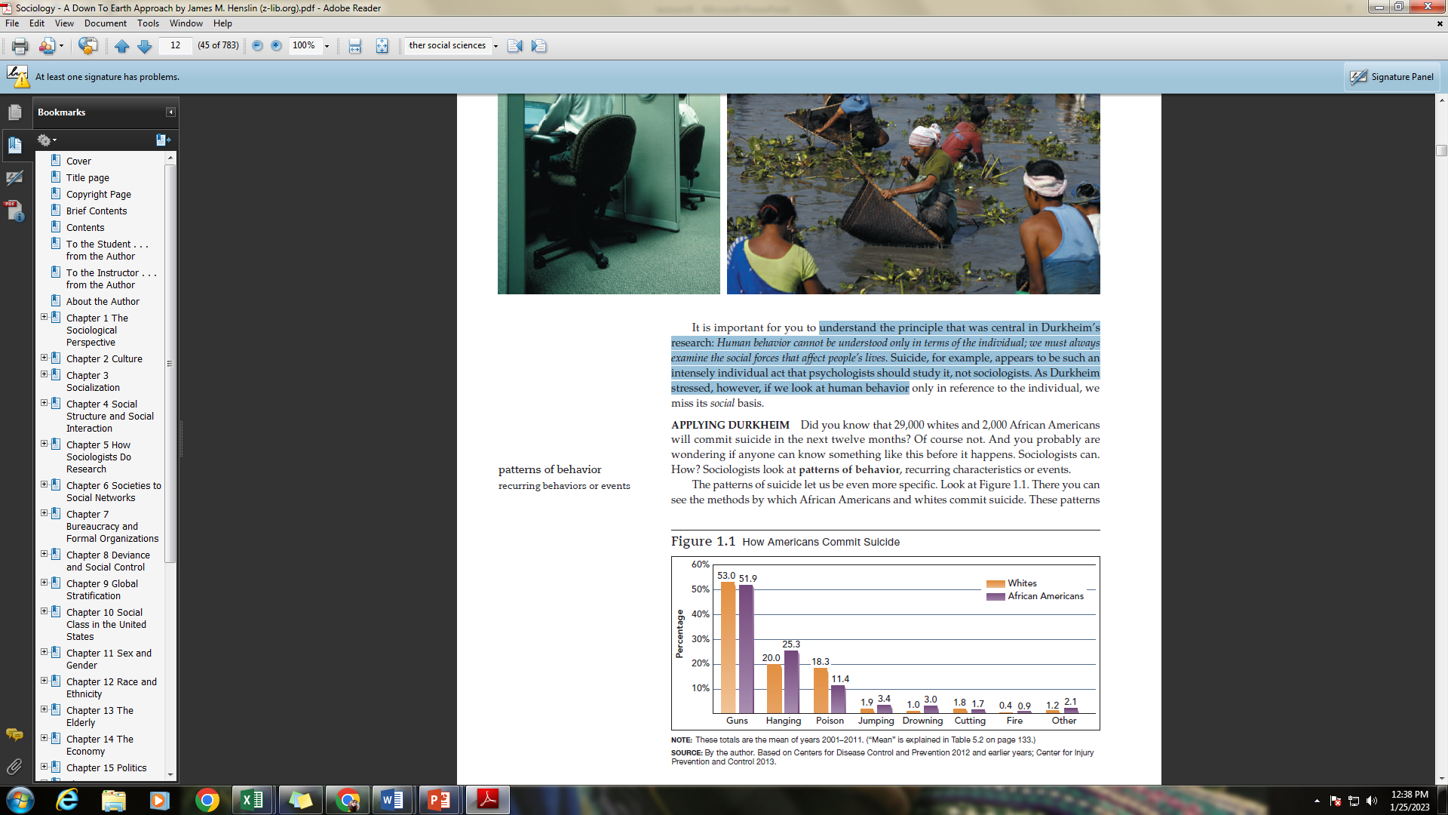

Slide 41

Social Solidarity- Emile Durkheim
Solidarity: Refers to the ties in a society that bind people together as one.
Mechanical Solidarity
Social cohesion and integration comes from the homogeneity of individuals. People feel connected through similar work, educational and religious training, and lifestyle, which is often based on the kinship ties of familial networks.
Organic Solidarity
is social cohesion based upon the dependence individuals have on each other in more advanced societies. It comes from the interdependence that arises from specialization of work and the complementarities between people.
Notes:
Solidarity is an awareness of shared interests, objectives, standards, and sympathies creating a psychological sense of unity of groups or classes

Slide 42
Division of labor
Durkheim saw division of labor as providing organic solidarity to modern societies. He argued as the division of labor expands people become more dependent on each other because each person needs goods and services that those in other occupation supply.

Slide 43
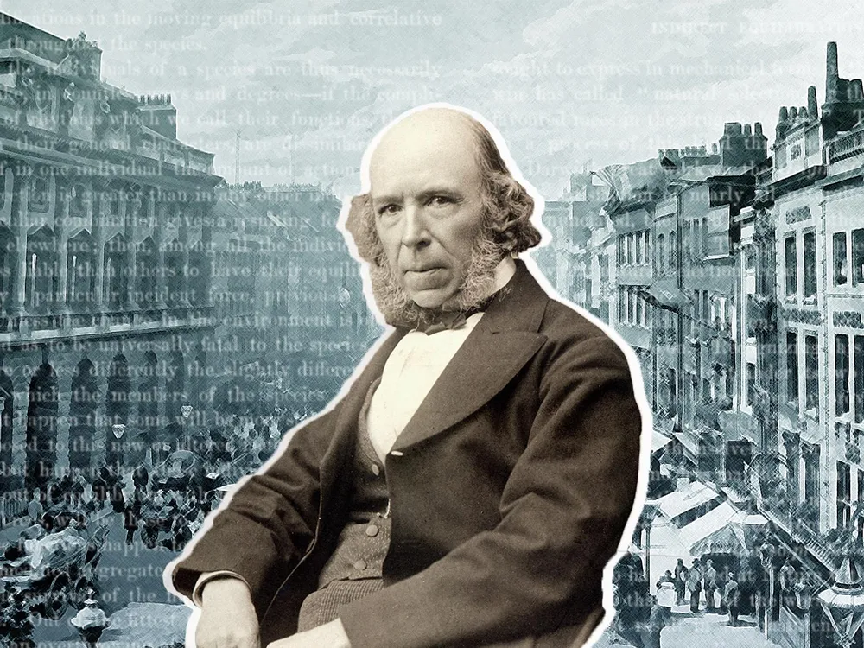
Herbert Spencer and Social Darwinism
Grew up in England (1820–1903), sometimes called the second founder of Sociology.
Coined the term “survival of the fittest.” Societies are evolving from a lower form (“barbarian”) to higher (“civilized”) forms. As generations pass, a society’s most capable and intelligent members (“the fittest”) survive, while the less capable die out. These fittest members produce a more advanced society—unless misguided do-gooders get in the way and help the less fit (the lower classes) survive.
Spencer called this principle the survival of the fittest. Although Spencer coined this phrase, it usually is credited to his contemporary, Charles Darwin.
He proposed that societies evolve over time as the fittest adapt to their environment, Darwin applied this idea to organisms. Because Darwin is better known, Spencer’s idea is called Social Darwinism.

Slide 44
Law of Social Evolution/ Social Darwinism
Charles Darwin’s notion of survival of the fittest - those species of animals best adapted to the environment survived and prospered, whereas those poorly adapted died out.
Spencer reasoned that people who could not successfully compete in modern society were poorly adapted to their environment and were therefore inferior. Spencer thought that helping the poor was wrong, that this merely helped the “less fit” survive.
Many people accepted social Darwinism because it served as a justification for their control over society.
Social Darwinism thus became a justification for the repression and neglect of African Americans following the Civil War. It was also used to justify policies that resulted in the devastation of Native American populations.

Slide 45
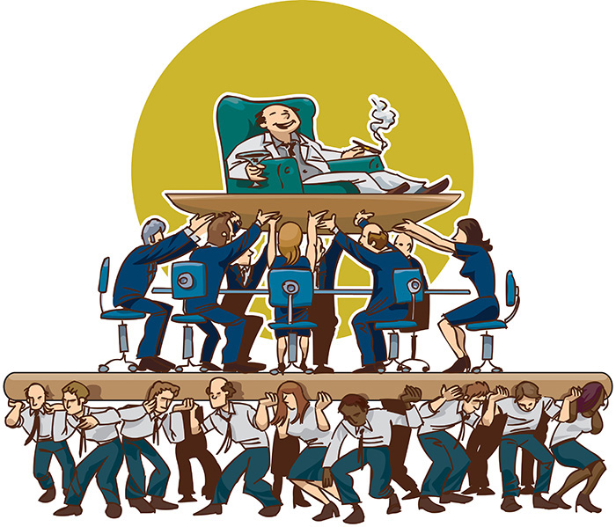
As Spencer noted: Human society is always in a kind of evolutionary process in which the fittest—which happened to be those who can make lots of money—were chosen to dominate. There were the armies of unfit, the poor, who simply could not compete. And just as nature weeds out the unfit, an enlightened society ought to weed out its unfit and permit them to die off so as not to weaken the racial stock. (Spencer, 1864, p. 444)

Slide 46

Laissez faire
Laissez faire is the belief that economies and businesses function best when there is no interference by the government.
Many Social Darwinists embraced laissez-faire capitalism and racism.
It comes from the French, meaning to leave alone or to allow to do. It is one of the guiding principles of capitalism and a free market economy.
It is the belief that each individual's self-interest to do better, strong competition from others, and low taxes will lead to the strongest economy, and therefore, everyone will benefit as a result.
They believed that government should not interfere in the “survival of the fittest” by helping the poor, and promoted the idea that some races are biologically superior to others.
Notes:
In the 18th century, French economists became upset with taxes and subsidies that were being imposed on their businesses. They believed that governments should leave the individual businesses alone, except when social liberties were infringed upon. In the 19th century, this philosophy became mainstream in the U.S. It wasn't long after this that the 'free market' approach started to display problems, such as large gaps in distribution of wealth, poor treatment of workers, and lack of safety in the workplace. By the mid-19th century, governments in most advanced countries became more involved in protecting and representing the safety and concerns of workers and the general population. This was the beginning of many of the factory laws and consumer protection laws that are being established and modified today.

Slide 47
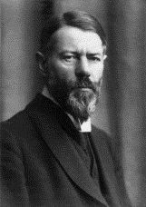
Max Weber and the Protestant Ethic
Religion and the Origin of Capitalism - Weber disagreed with Marx’s claim that economics is the central force in social change. That role, he said, belongs to religion. In Weber’s view, economic factors are important, but ideas and values have just as much effect on social change.
(1864–1920), a German sociologist and a contemporary of Durkheim
Weber showed that religion could be a belief system that contributed to the creation of new economic conditions and institutions.
Weber tried to demonstrate how the Protestant Reformation of the seventeenth century provided an ideology that gave religious justification to the pursuit of economic success through disciplined, hard work.

Slide 48

Weber theorized that the Roman Catholic belief system encouraged followers to hold on to traditional ways of life, while the Protestant belief system encouraged its members to embrace change. Roman Catholics were taught that because they were Church members they were on the road to heaven, but Protestants, were told that they wouldn’t know if they were saved until Judgment Day.
Uncomfortable with this, they began to look for “a sign” that they were in God’s will. They found this “sign” in financial success, which they took as a blessing that indicated that God was their side. To bring about this “sign” and receive spiritual comfort, they began to live frugal lives, saving their money and investing it in order to make even more. This, said Weber, brought about the birth of capitalism.
Weber called this self-denying approach to life the Protestant ethic. He termed the desire to invest capital in order to make more money the spirit of capitalism.

Slide 49
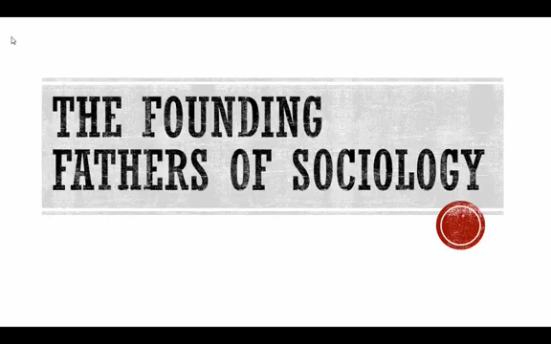
Video link
https://www.youtube.com/watch?app=desktop&v=7QSsrb--HPo

Slide 50


